Slide 1

Welcome to
Python from Scratch

Slide 2

About Me:
UGC-NET (2019)qualified for Assistant Professor
4+ years of experience in Teaching
IBM Certified in Data Science
IBM certified In Machine Learning with Python
Certified in Python from University of Michigan, USA
Currently working on project for Innodatatics, USA
Went as Resource Person for Tableau Workshop
Nagararju Ekkirala
LinkedIn ID: Nagaraju Ekkirala

Slide 3


Introduction:
Python was developed by Guido Van Rossum
Python 1.0V introduced in Jan 1994
Python 2.0V introduced in October 2000
Python 3.0V introduced in December 2008
latest version : Python 3.11.1
Python doesn’t support backward compatibility

Slide 4
Features of Python:
Simple and easy to learn
Open Source
Interpreted language
Platform Independent
Dynamic Type
Rich Library
High Level Programming Language
Function Oriented and Object Oriented

Slide 5

Hello World
JAVA:
class HelloWorld {
public static void main(String[] args) {
System.out.println("Hello, World!");
}
}
C Program:
#include <stdio.h>
int main() {
printf("Hello, World!");
return 0;
}
Python:
print(“Hello World”)

Slide 6
public class SumOfNumbers1
{
public static void main(String args[])
{
int n1 = 225, n2 = 115, sum;
sum = n1 + n2;
System.out.println("The sum of numbers is: "+sum);
}
}
include <stdio.h>
int main()
{
int A, B, sum = 0;
printf("Enter two numbers A and B : \n");
scanf("%d%d", &A, &B);
sum = A + B;
printf("Sum of A and B is: %d", sum);
return 0;
}
Python:
A=225,b=115
print(a+b)

Slide 7
Limitations
Speed Limitations
Not applicable for mobile Applications
Poor memory efficiency

Slide 8
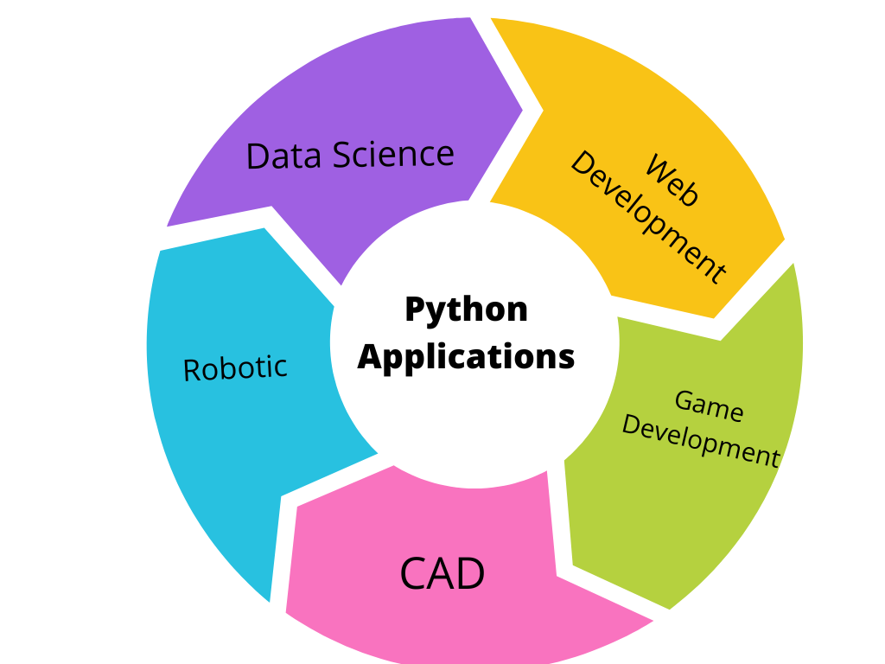
Applications:
Desktop Applications
web Applications
Network Programming
Machine Learning
IoT
Artificial Intelligence Applications
Pic credit:www.henryharvin.com

Slide 9
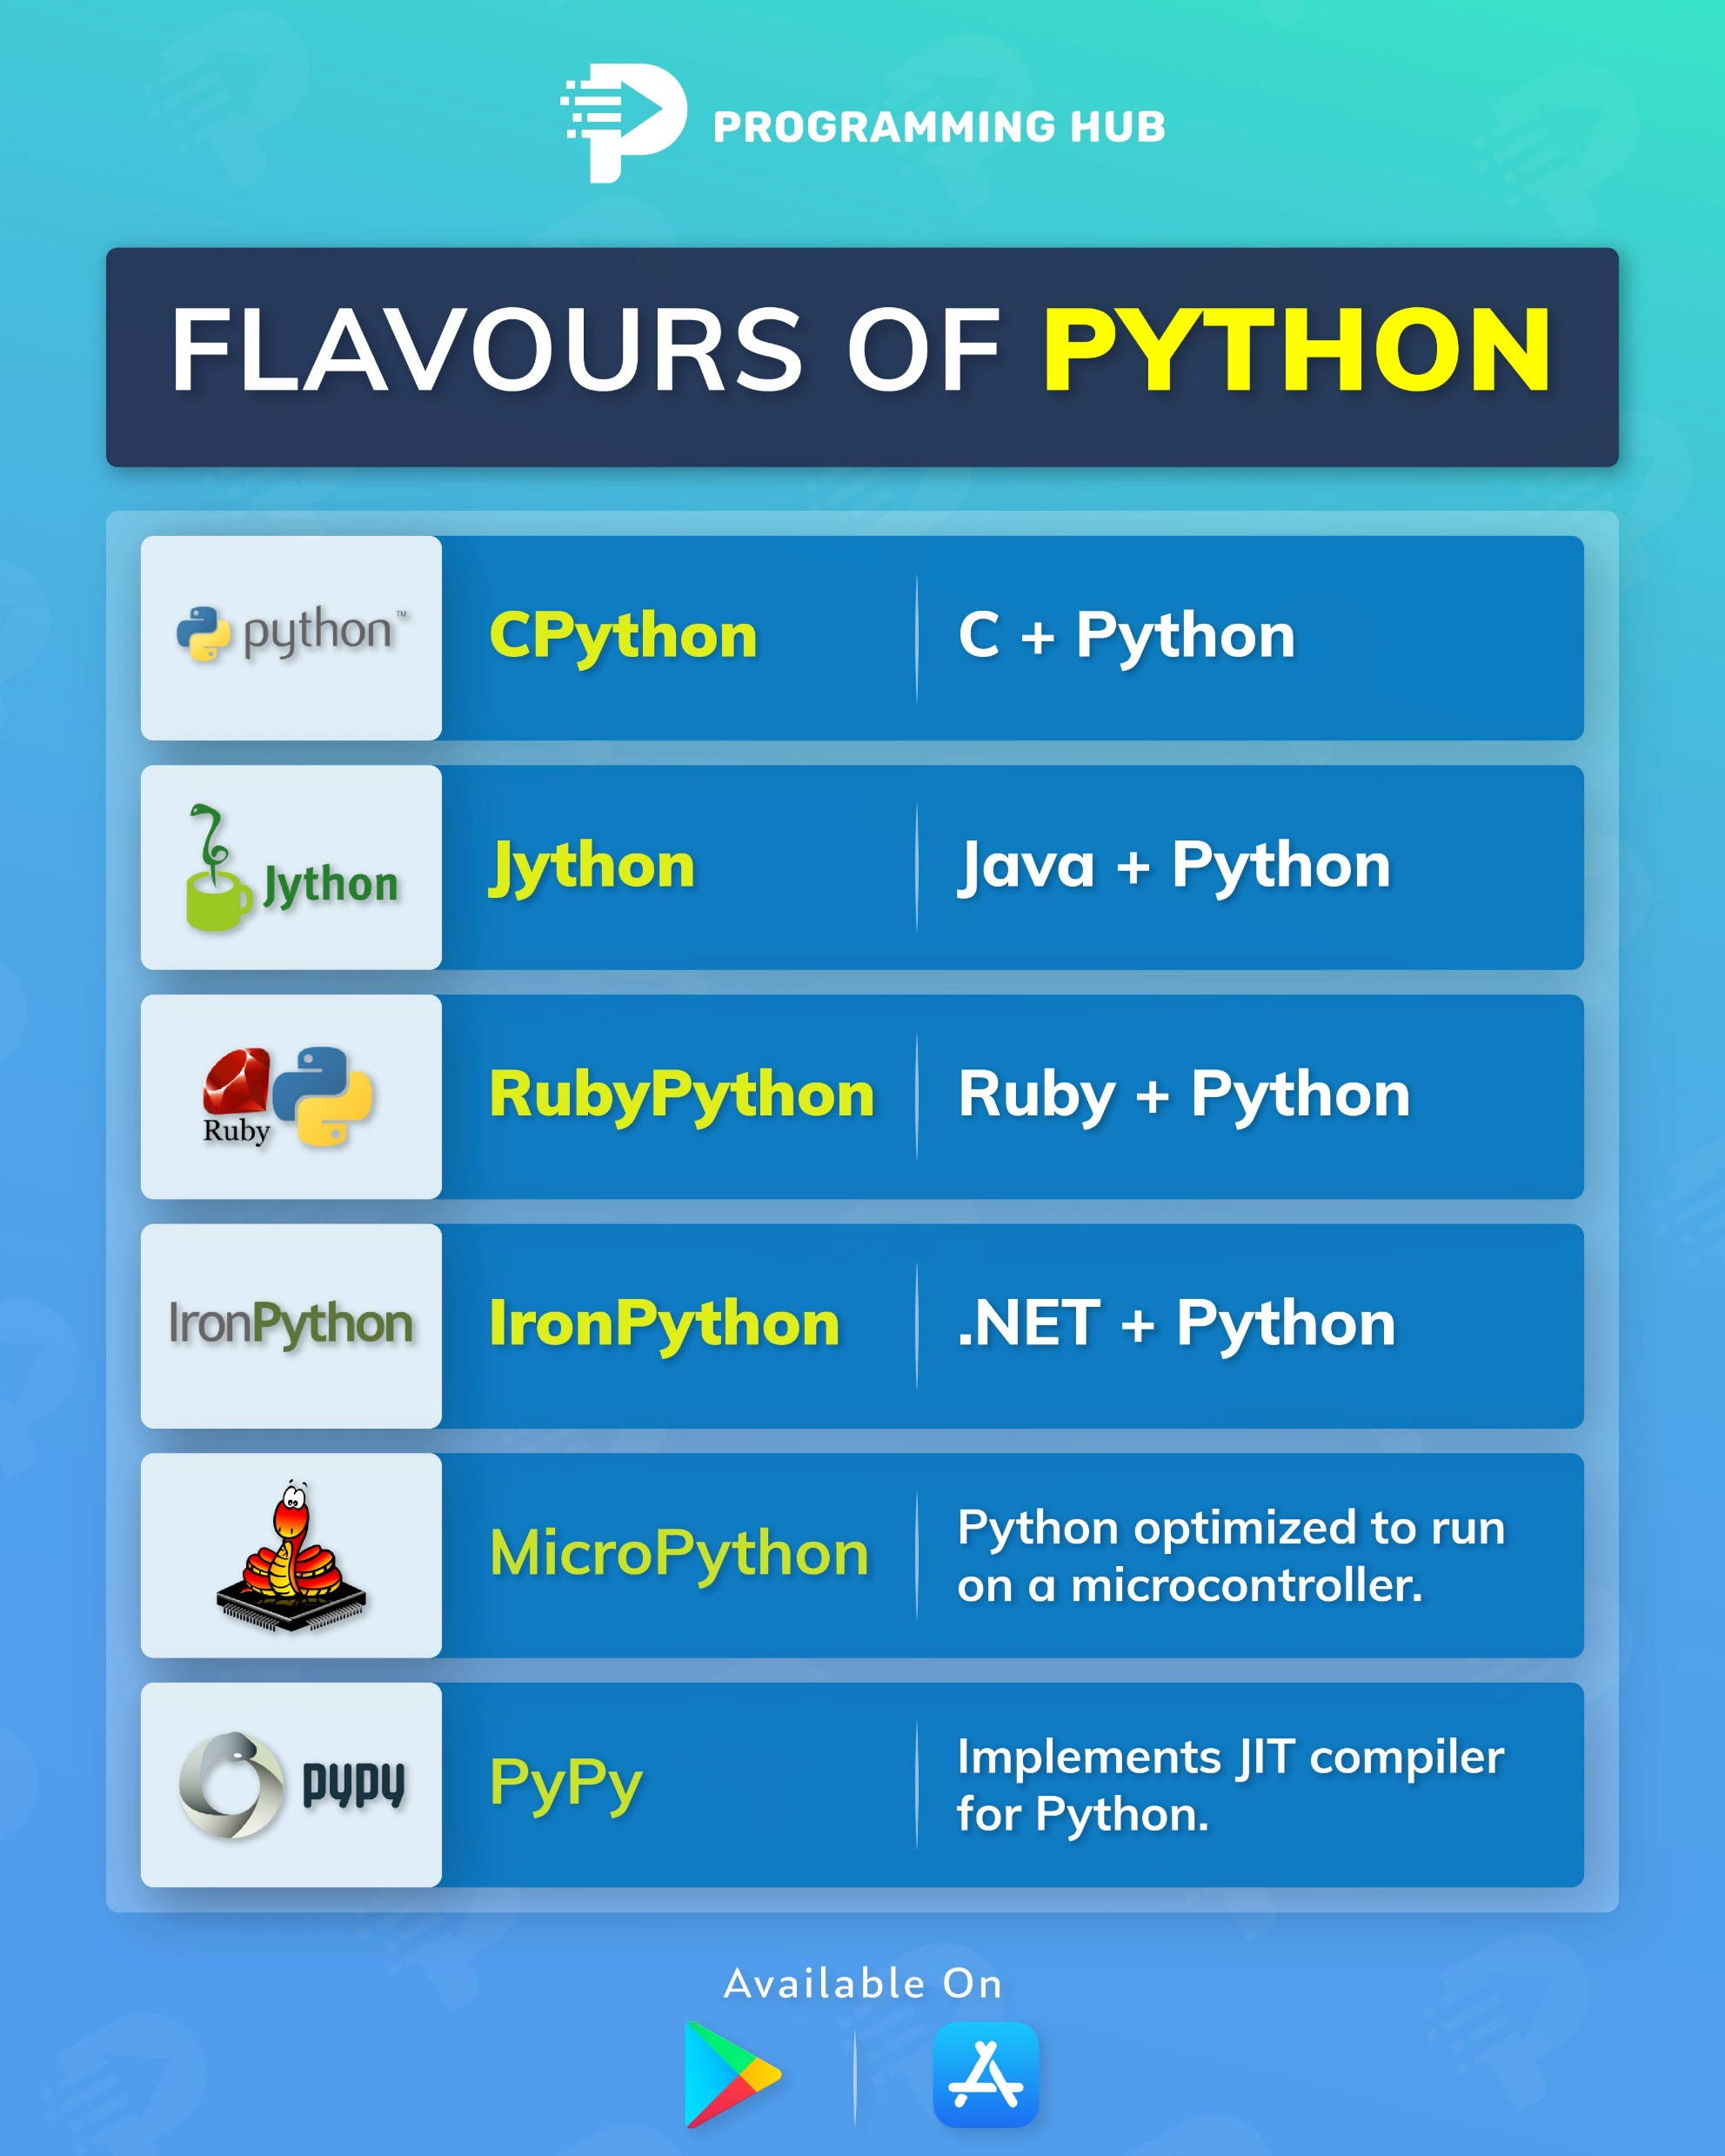

Slide 10
Installing Python
For Python IDLE ,click on this link click here
For anaconda, Click on this link click here

Slide 11
Identifiers:
Naming to entity
It can be Class Name (or )Function Name (or) Module Name (or) Variable Name.(or) object name
Ex:
var1=45 value= True
name=“Python”
city=“Hyderabad”
Name

Slide 12


Caution: The following rules must obey while creating variable name
In the letters should be alphanumeric values & underscore( _ )
i.e. 0-9, a-z, A-Z and _
Ex:
A=100
Sum=300
Var234=“hello”
Name_1=“Python”
Identifier should not start with Digits. Ex: 234var=“hello”
We should not use reserved words Ex: for=123
Shouldn’t use any special symbol: Ex: r@j=90

Slide 13
Remember:
Identifiers are case sensitive.
ex: Sum=100
sum=100
There is no length limit for Python identifiers.
If identifier starts with _ symbol then it indicates that it is private.
If identifier starts with __(Two Under Score Symbols) indicating that strongly private identifier
If the identifier starts and ends with two underscore symbols then the identifier is language defined special name, which is also known as magic method
Two types: Local variable,Global Variables
ex: __init__

Slide 14
Evaluation:
What are the following valid identifier name
python=456
name_1= “Hello”
12name=“Good Evening”
_name=“Hyderabad”
name12=“College”
ADD=12
add=23
Raj&12=90

